Slide 1

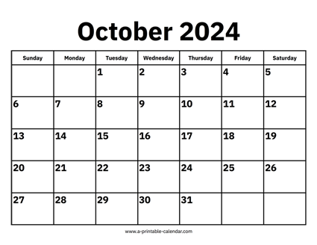

CS 310 : Scalable Software Architectures
Week 02 (Sept 30 – Oct 4)
This week in CS 310:
Focus this week:
Relational databases
Class sessions *are* being recorded this week
Will be available under Panopto on Canvas
Project 01 due Wednesday Oct 9th @ 11:59pm
Build a simple photo app using AWS
Part 01 has been released, configuration of AWS
Part 02 to be released, client-side programming
TA office hours start Monday 9/30
See links on Canvas

Slide 2
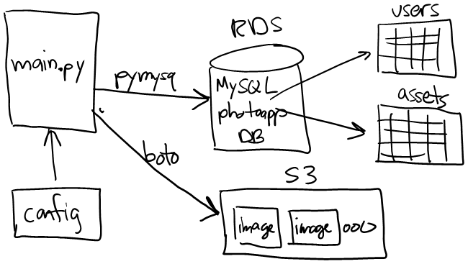
Project 01

Slide 3
Topics
Relational databases
SQL (select, insert, update, delete)
Database design (3 most important rules)
Optimizing database access (indexing)
Programmatic access via Python
Notes:
Assuming no background in databases / SQL
Optional practice assignments on Canvas (HW01, HW02)

Slide 4
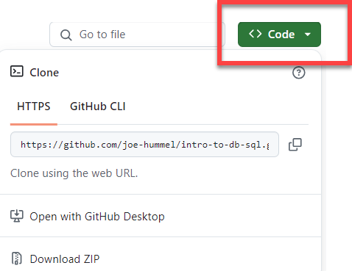
Class sessions
Summarize key points of lecture
Write SQL using sqlite3 and MySQL
Execute SQL using python with sqlite3 and MySQL
Notes:
To work in class, make sure Docker Desktop is installed
Provided software uses Docker, download files from GitHub:
https://github.com/joe-hummel/intro-to-db-sql
Clone repo or download ZIP

